Slide 1
AUDIT ANALYSIS – VERTEX PHARMACEUTICALS
ALY 6080 Experiential project
Instructor : Mr. Amin Karimpour
Done by
Anish Nitin SOMAIAH

Slide 2
Introduction
Vertex Pharmaceuticals, Inc. ,an American biopharmaceutical company located in Boston, Massachusetts, is one of the first biotech firms to use an explicit strategy of rational drug design rather than combinatorial chemistry.
Vertex is known to have designed and developed the first medicines to treat the underlying cause of a rare significant life-threatening genetic disease named CYSTIC FIBROSIS.
As per investment data the organization has earned an investment of 166.18M$ during the first quarter of 2019 from NASDAQ exchange for its upcoming projects in Research & Development.

Slide 3
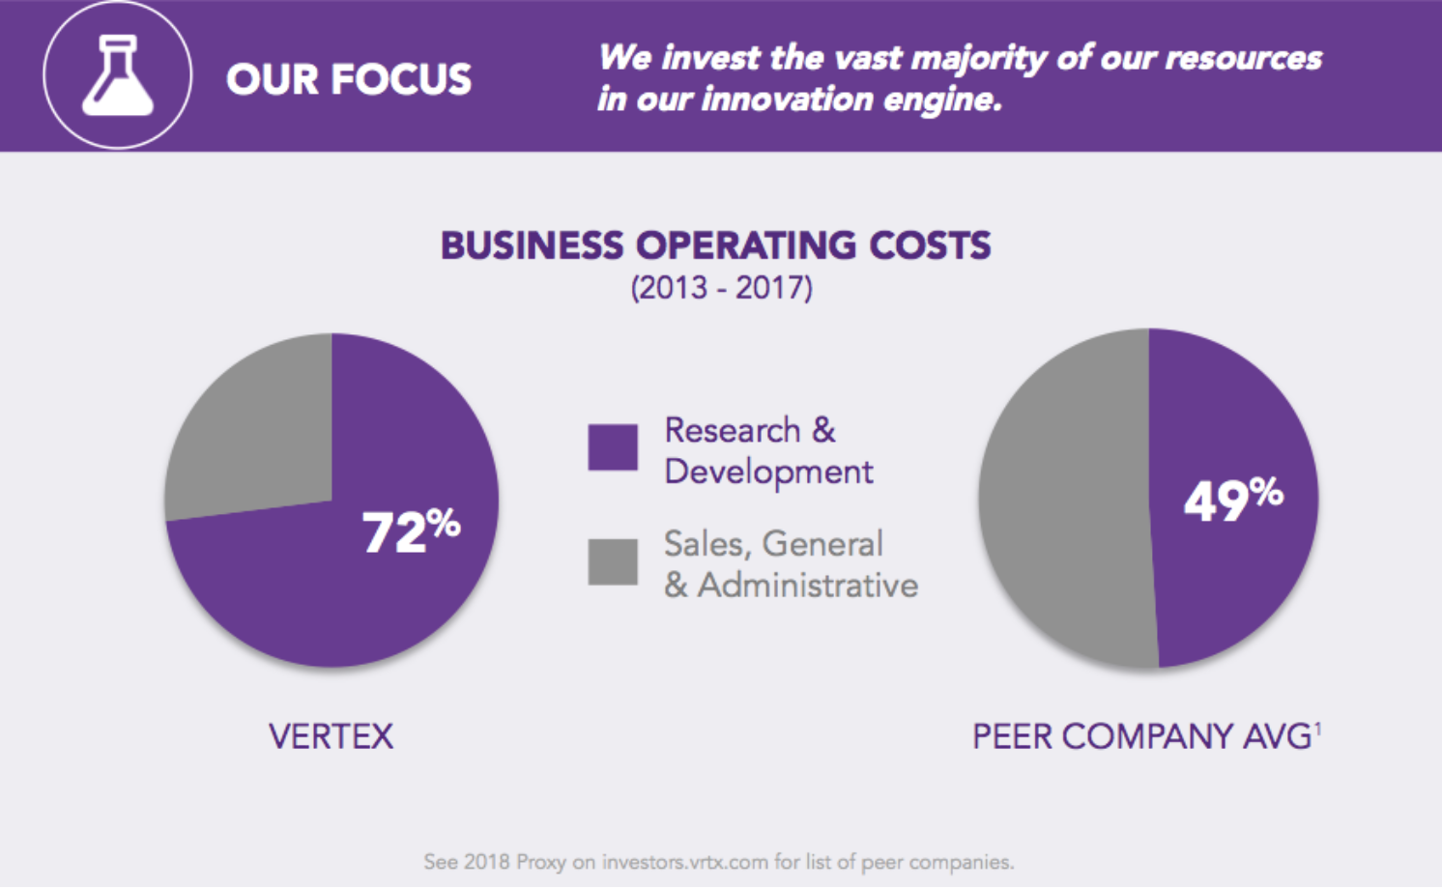
PROJECT OBJECTIVE
To figure an optimum solution to regulate the vendor activities for different scenarios, optimize the 28% of the revenue for efficient vendor performances, provide cost efficient methods to ensure sustained vendor supply activity.

Slide 4
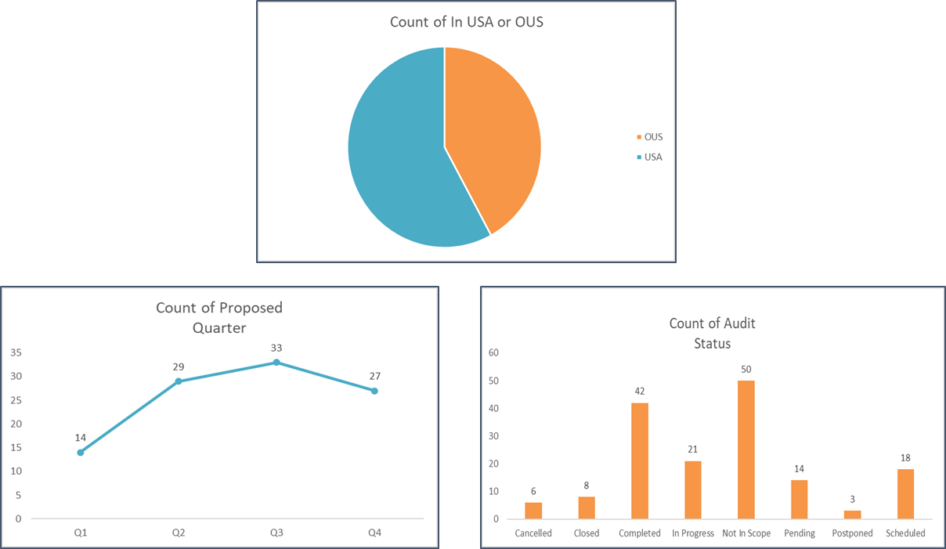
CURRENT 2018 Statistics
Around 58% of the audits are within USA and 42% are Outside USA in 2018
Only 42/163 ( 25.7% ) audits have been completed. And 50/163 have been pushed out of scope. Our data doesn’t give any clarity about the reason about being declared not in scope.

Slide 5
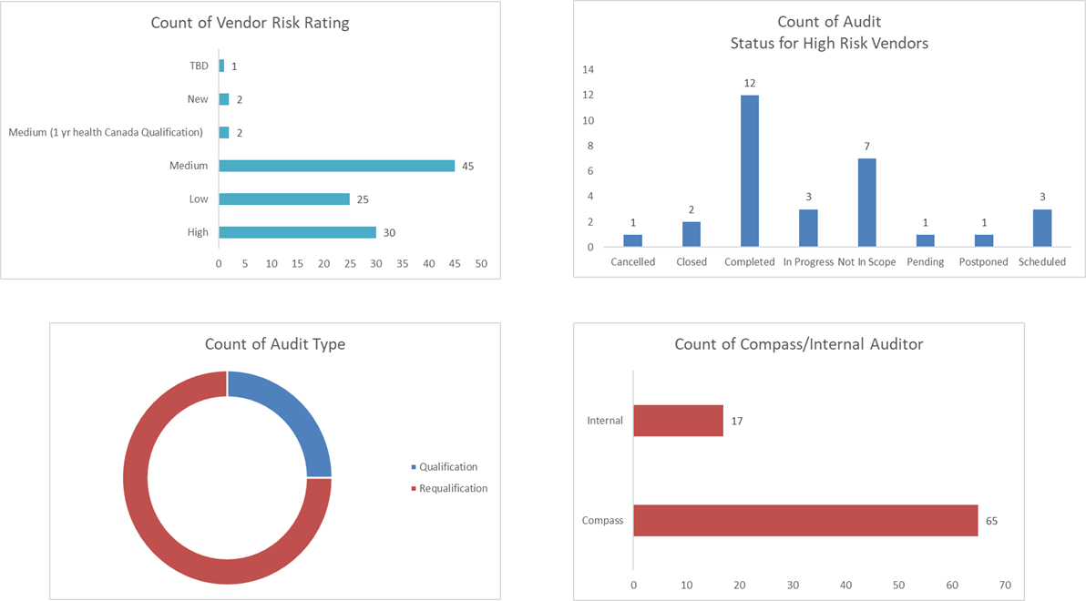
CURRENT 2018 Statistics - contd
40% of the high risk-audits were completed which is a good sign. Hence concentration can be shifted towards the medium and low risked vendors.
We also observe 75% of the audits were Requalification. This can be assumed that either the qualification audit was not implemented right or the product was essential for further R&D.
65/82 audits in 2018 were done by a third-party company.

Slide 6
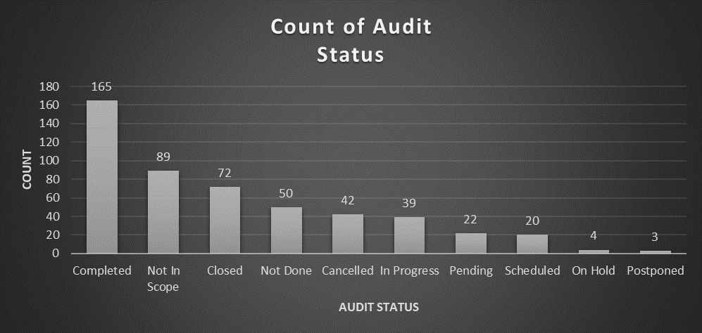
EXPLORATORY DATA ANALYSIS
Out of the total 506 audits carried out since 2015, 165 is in completed status which is the highest of the lot. Hence we consider the completed status EDA to find out metrics to obtain the completion of other audits.

Slide 7
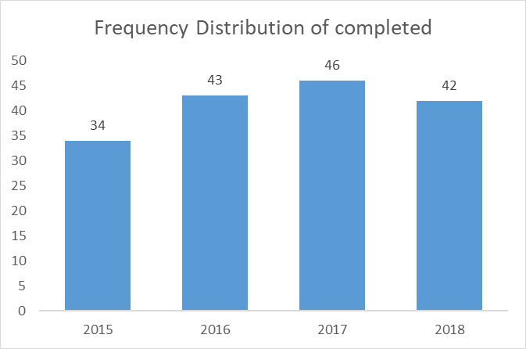
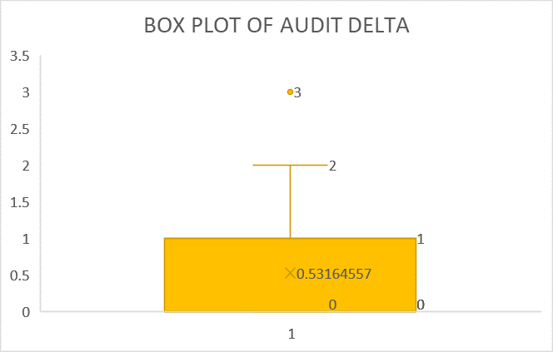
EXPLORATORY DATA ANALYSIS - CONTD
From the graph we infer that the distribution is almost normal with peak no.of audits completed in 2017. Hence any standardized machine learning algorithm can be applied to this dataset for further predictions.
From the box plot we infer that the average time between audit start and audit end date is 0.5-1 days with peak of 2 days. There was only one outlier among the completed audits where there was a gap of 3 days between audit start and end date.
NOTE: this is just time difference between audit start and audit end date

Slide 8
EXPLORATORY DATA ANALYSIS - CONTD
questionnaire delta |  |  | audit delta |  |  | audit completion delta
Mean | 2.40 |  | Mean | 0.532 |  | Mean | 103.46
Standard Error | 1.01 |  | Standard Error | 0.054 |  | Standard Error | 9.50
Median | 0.00 |  | Median | 0.000 |  | Median | 85.00
Mode | 0.00 |  | Mode | 0.000 |  | Mode | 0.00
Standard Deviation | 12.78 |  | Standard Deviation | 0.674 |  | Standard Deviation | 110.84
Sample Variance | 163.42 |  | Sample Variance | 0.454 |  | Sample Variance | 12285.39
Kurtosis | 49.40 |  | Kurtosis | 0.381 |  | Kurtosis | -0.59
Skewness | 6.79 |  | Skewness | 1.021 |  | Skewness | 0.78
Range | 107.00 |  | Range | 3.000 |  | Range | 369.00
Minimum | 0.00 |  | Minimum | 0.000 |  | Minimum | 0.00
Maximum | 107.00 |  | Maximum | 3.000 |  | Maximum | 369.00
Sum | 387.00 |  | Sum | 84.000 |  | Sum | 14071.00
Count | 161.00 |  | Count | 158.000 |  | Count | 136.00
Questionnaire Delta = difference between Q sent and Q received
Audit Delta = difference between Audit start date and Audit end date
Audit Completion Delta = difference between date intake and date completion

Slide 9
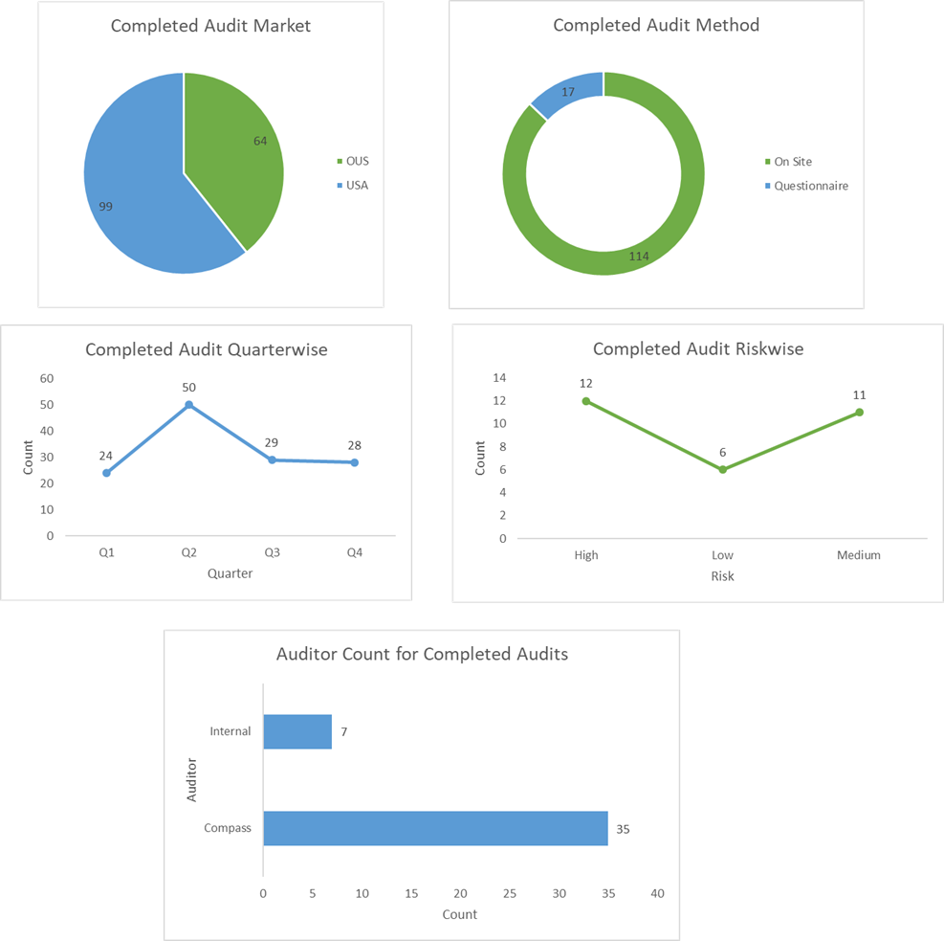
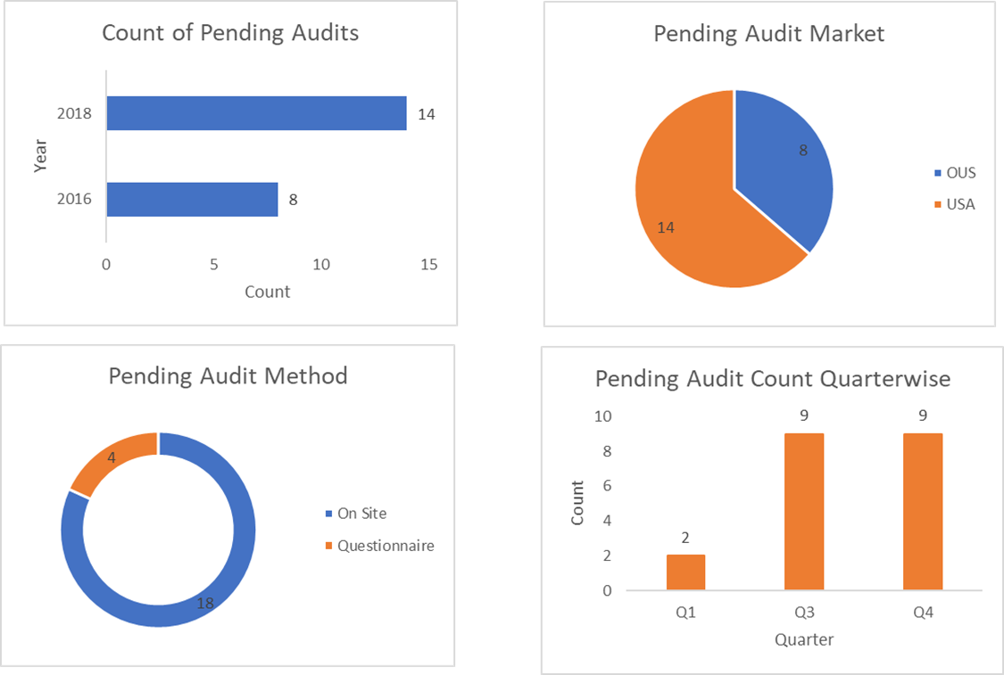
TREND DATA ANALYSIS

Slide 10
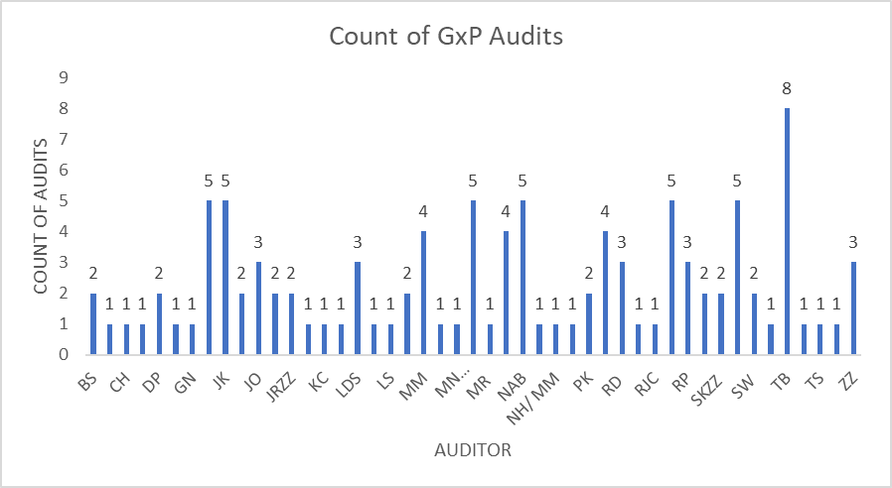
GXP AUDITOR DATA ANALYSIS
Audit Method | Count |  | Audit Status | Count
On Site | 83 |  | Cancelled | 5
Questionnaire | 16 |  | Closed | 20
Remote | 1 |  | Completed | 61
Method Unknown | 7 |  | In Progress | 5
 |  |  | Not In Scope | 7
 |  |  | Pending | 2
 |  |  | Scheduled | 7
107 audits done by 47 auditors.
57 audits took place in USA and 50 outside of USA.
It takes an average of 178 days to complete an onsite audit OUS and but 190 days to complete an audit within USA.
Only 3/107 audits were carried out by Internal Auditors.

Slide 11
GxP AUDITOR DATA ANALYSIS - CONTD
TB has completed 5/8 audits which are Outside USA onsite audits and he has taken an average of 186 days to complete.
To optimize manpower, as a majority are Compass auditors, 5 auditors who have done single audits and who has taken more than average no.of days to complete the audit can be assigned to a single auditor.
If this metric is used, we have 14 audits which are pending which are assigned to 14 different auditors, these audits can be done by approximately 3 auditors who have already completed their audits
The 14 auditors can be moved to the 200 remaining audits where we do not have auditor details or CSQA audits to improve efficiency with same cost or these auditors can be removed to cut cost for vertex.
Year | Audit Status | In USA or OUS | audit completion delta
2018 | Pending | OUS
2017 | Not In Scope | OUS
2017 | Not In Scope | OUS
2017 | Completed | OUS | 112
2017 | Completed | OUS | 147
2017 | Completed | OUS | 357
2017 | Completed | OUS | 154
2017 | Completed | OUS | 155

Slide 12
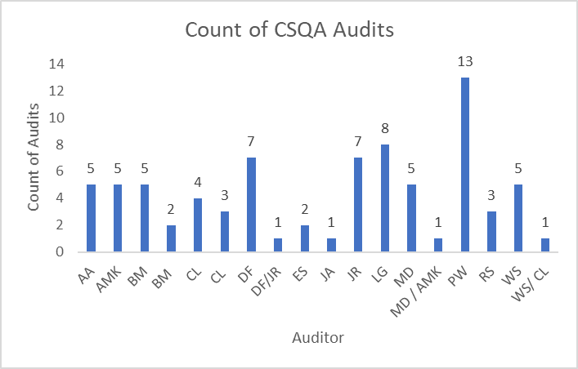
Csqa auditor analysis
Audit Type | Count |  | Audit Status | Count
Internal | 5 |  | Cancelled | 7
Qualification | 19 |  | Closed | 34
Requalification | 54 |  | Completed | 23
 |  |  | In Progress | 7
 |  |  | Not In Scope | 1
Audit Method | Count |  | On Hold | 2
On Site | 54 |  | Pending | 1
Questionnaire | 24 |  | Scheduled | 3
78 audits have been done using 18 auditors.
The challenge for CSQA audits is that the organization details are blank for 56/78 audits
Takes an average of 178 days to complete an onsite audit OUS and but 190 days to complete an audit within USA.

Slide 13
Csqa auditor analysis - CONTD
Year | Audit Status | In USA or OUS | Audit Method | audit completion delta
2017 | Completed | USA | On Site | 266
2017 | On Hold | USA | On Site | no completion date
2017 | On Hold | USA | On Site | no completion date
2016 | Closed | USA | Questionnaire | 0
2016 | In Progress | USA | On Site | no completion date
2016 | Closed | USA | On Site | no completion date
2016 | Complete | USA | On Site | 0
2016 | Closed | OUS | Questionnaire | no completion date
2016 | Closed | USA | On Site | 0
2016 | Closed | OUS | Questionnaire | 0
2016 | Closed | OUS | Questionnaire | 0
2016 | In Progress | USA | Questionnaire | no completion date
2016 | Closed | USA | On Site | 0
Considering the entire CSQA audit completed status audits, on an average it takes 135 days to complete a CSQA audit. This has been derived from the 23 completed audit cases.
One important find is that among these 23 cases, 6 audits were completed by auditor CL with an average of 110 days.
Hence with this insight we can say that in our distribution graph we have 1 audit carried out by single auditor which can be reduced to 4~5 audits per person to reduce manpower and utilize in the pending/in progress audits.

Slide 14
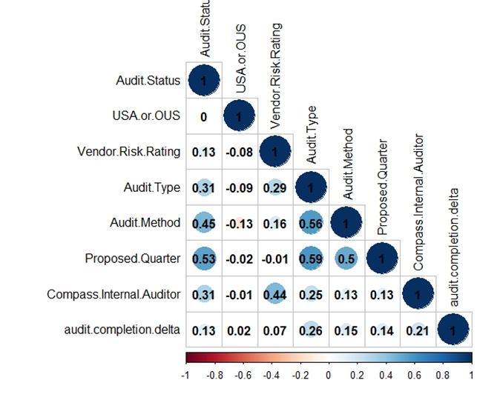
CORRELATION ANALYSIS AND MODEL PROPOSAL
A very low correlation of audit completion delta with other variables. Hence a regression model proposed with all these variables would be slow due to many dependent variables and less accurate due to low correlation.
However, a strong correlation is found between Audit status with Audit Method, Proposed Quarter and Audit organization. Hence a classification model can be made to propose the audit status using decision trees or logistic regression however with only 40% of data availability , the model accuracy is questionable.

Slide 15
THANK YOU

